Slide 1
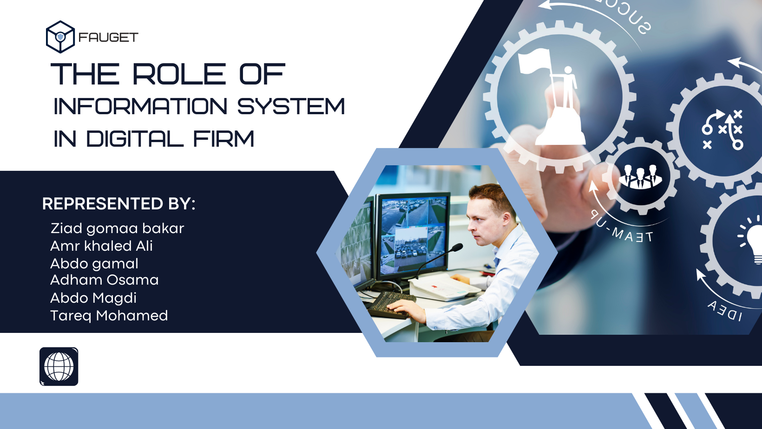

Slide 2
Introduction : What is the definition of information system ?
An information system (IS) is a formal, sociotechnical, organizational system designed to collect, process, store, and distribute information. From a sociotechnical perspective, information systems comprise four components: task, people, structure (or roles), and technology. Information systems can be defined as an integration of components for collection, storage and processing of data , comprising digital products that process data to facilitate decision making[and the data being used to provide information and contribute to knowledge.
A computer information system is a system, which consists of people and computers that process or interpret information.[The term is also sometimes used to simply refer to a computer system with
software installed.

Slide 3
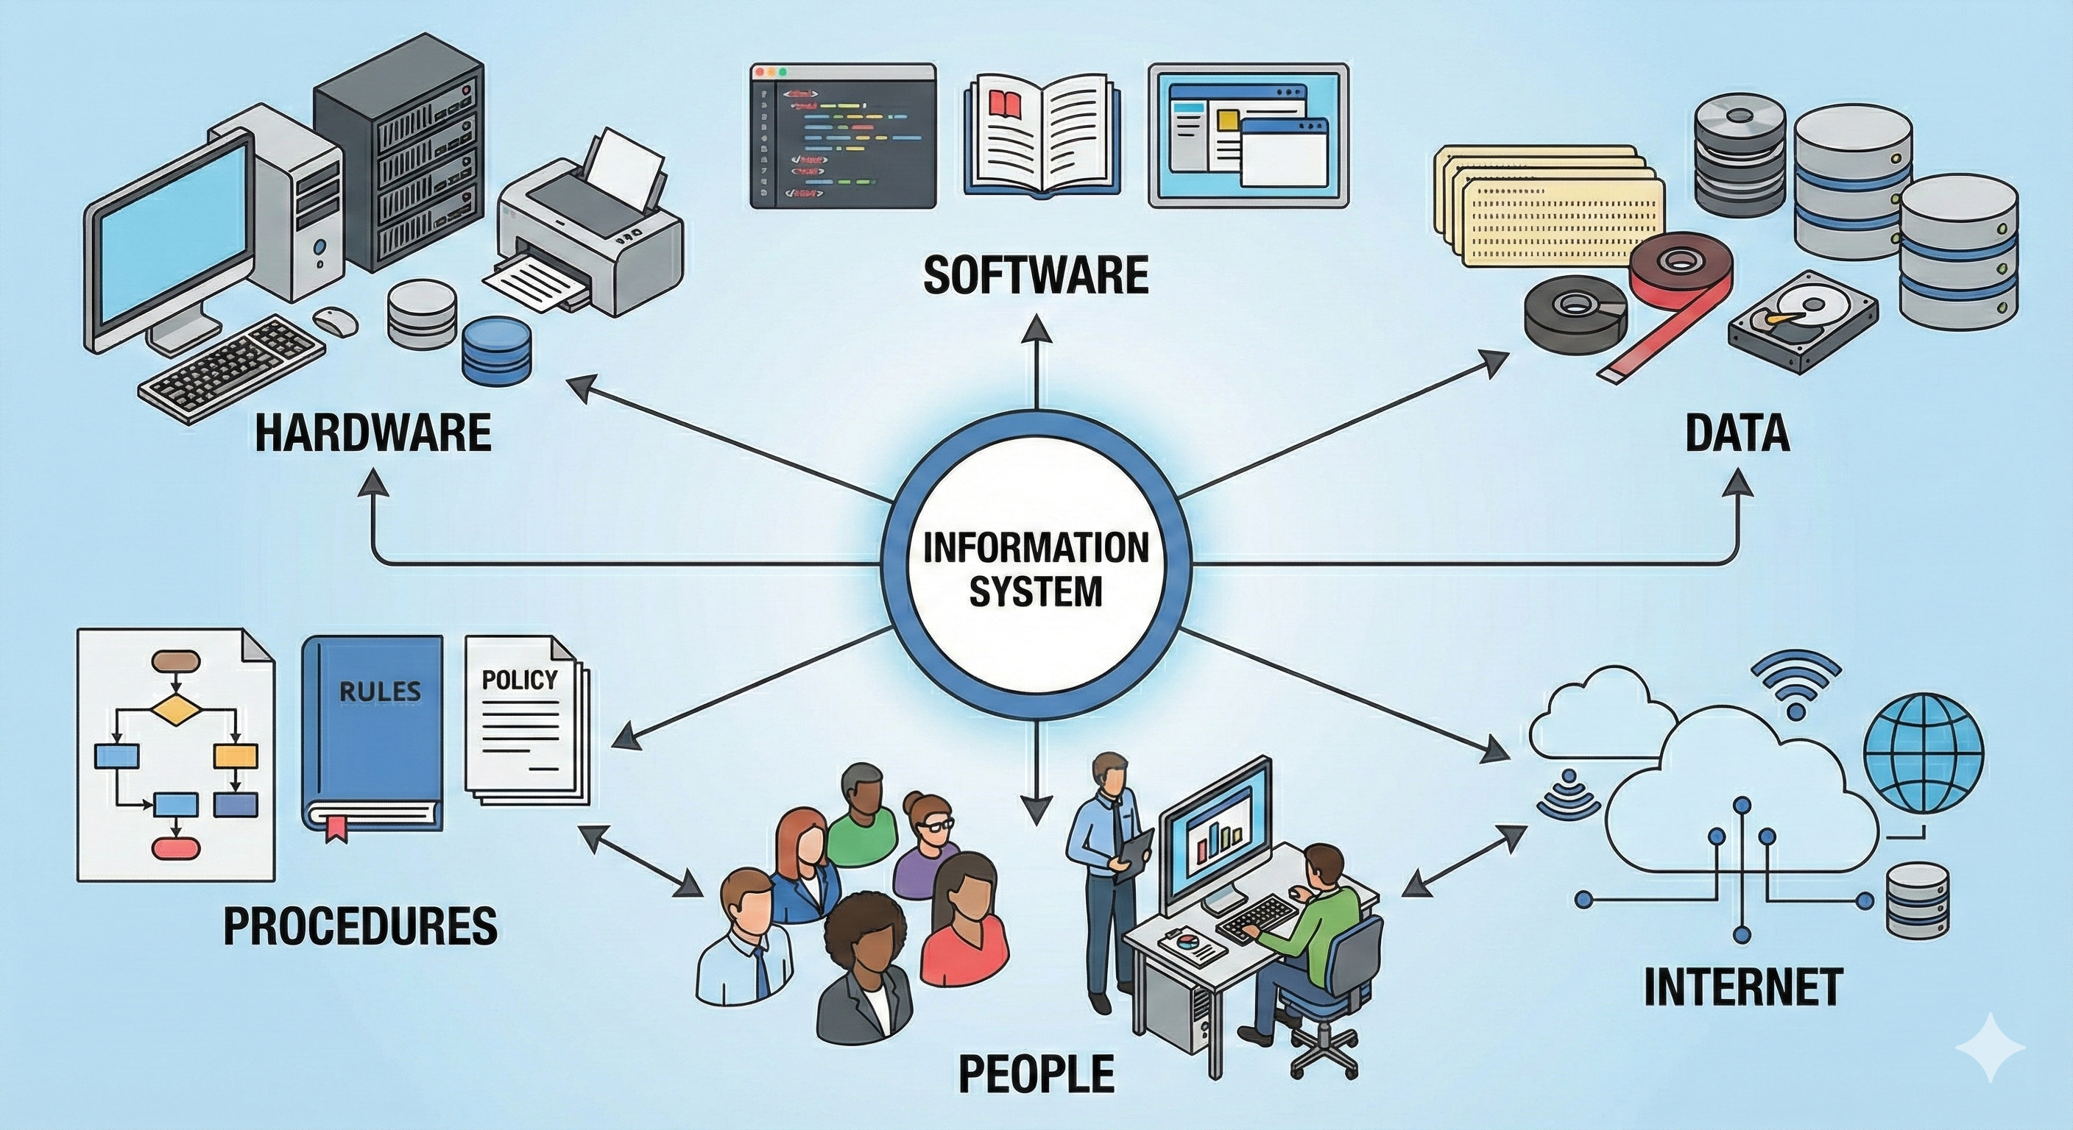
Components of information system : software, hardware, data, people, and procedures .
•Software : The term software refers to computer programs .
• Hardware : The term hardware refers to machinery and equipment .
• Data : Data are facts that are used by systems to produce useful information .
• Procedures : Procedures are the policies that govern the operation of an information system .
• People : Every system needs people if it is to be useful

Slide 4
Digital firms : A Digital Firm is an organization where nearly all significant business relationships with customers, suppliers, and employees are digitally enabled and mediated. In short, it is not just a company that uses computers; it is a company where technology is the core foundation of how it operates, survives, and grows.
Some Characteristics of digital firms :
Digitally Enabled Relationships: Core interactions with customers, suppliers, and employees are mediated and managed entirely through digital networks.
Data-Driven Decision Making: Strategic decisions rely on real-time data analytics to predict trends and personalize services instead of guesswork.
Space Shifting: Work is performed globally across boundaries, meaning physical location no longer limits business operations.
Time Shifting: Business operates continuously 24/7, effectively eliminating traditional "9-to-5" time constraints.

Slide 5
Transaction processing system (TPS)
Definition :
A transaction processing system (TPS) is a type of data management information-processing software used during a business transaction to manage the collection and retrieval of both customer and business data.
Key components of a transaction processing system :
Inputs :
Any number of transactions, including invoices, bills, coupons and other types of orders like a purchase order, may be treated as inputs in a TPS. Theoretically, any type of order entry can be considered input data.
Outputs :
A TPS can generate a variety of use-case-specific outputs ranging from cash flow reports to receipts, and it can be utilized for record-keeping, data analysis, tax reporting and other official business purposes.

Slide 6
Management information system (MIS)
Definition :
A management information system (MIS) is an information system used for decision-making, and for the coordination, control, analysis, and visualization of information in an organization. The study of the management information systems involves people, processes and technology in an organizational context. In other words, it serves, as the functions of controlling, planning, decision making in the management level setting .
Key Characteristics of MIS :
Input :
The basic transaction data from TPS
Output :
• regular schedule.
• Simple routines (summaries comparisons).

Slide 7
Decision Support System (DSS)
Definition :
A decisions support system is a computer program corporations can use to analyze data so managers can make decisions, find efficiencies, and cut costs .
Key Characteristics of DSS :
Input :
• Use internal information from TPS and MIS.
• Use external sources, such as current stock prices and product prices of competitors.
Output :
•-depends on what if method
• Try to answer questions such as these: ( What would the impact on production schedules if we were to double sales in the month of December? - What would happen to our return on investment if a factory schedule were delayed for six months?)

Slide 8
Executive Support System (ESS)
Definition :
An Executive Support System (ESS) is a type of management information system that is specifically designed to support the strategic decision-making needs of senior executives in an organization. It provides easy access to internal and external information relevant to the organization's goals and operations, enabling executives to make informed and timely decisions.
Key Characteristics of ESS :
Input :
• external events, such as (new tax laws – competitors)
• internal MIS and DSS
Output :
• Filter, compress, and track critical data displaying the data of greatest importance to senior managers.
• Provide data in the form of (Graphs – Charts Dashboards)

Slide 9
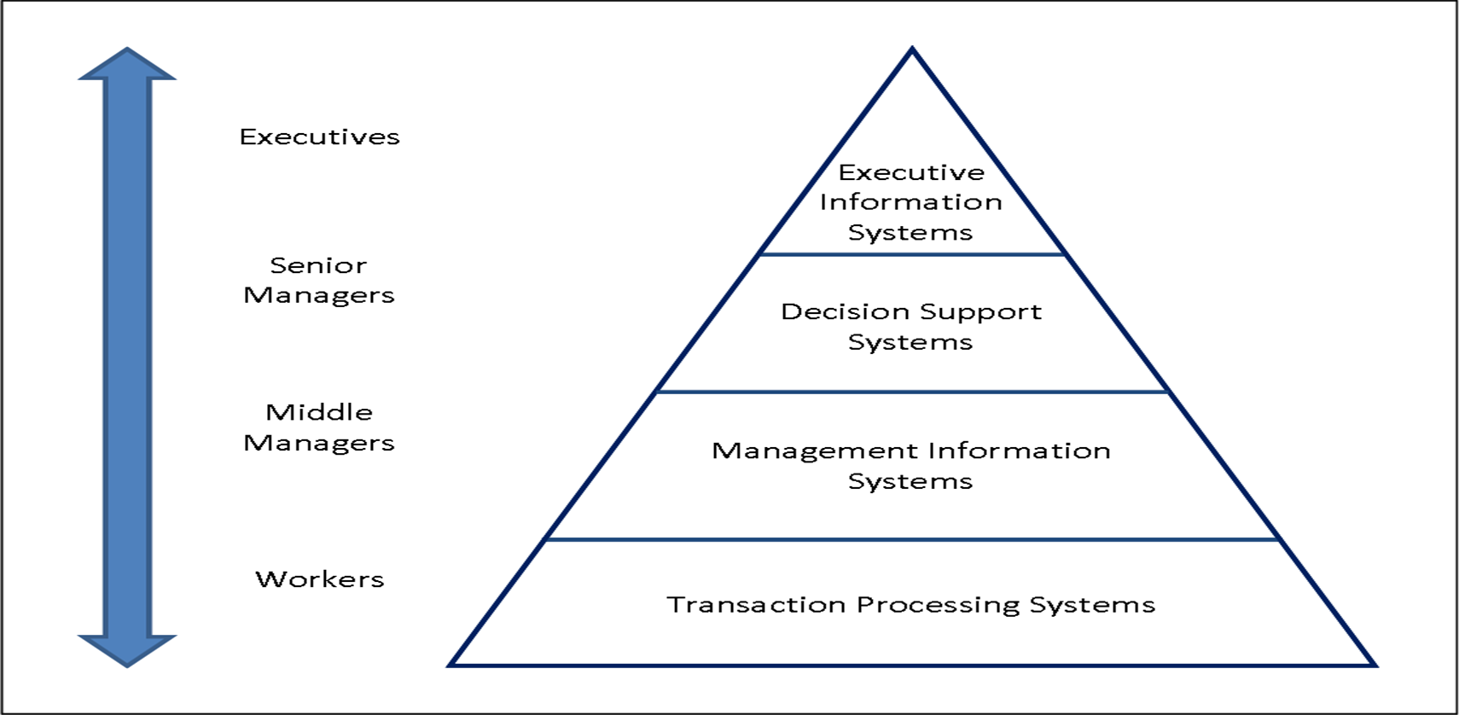
Ranking of previous systems by level :

Slide 10
What are enterprise applications ?
Enterprise applications are large-scale software solutions designed to streamline and automate various processes of an organization’s operations. These solutions are intended to increase productivity, efficiency and collaboration across departments.
Some characteristics of enterprise applications :
Centralized management: Centralized control of business functions and the ability for administrators to efficiently monitor and update the system.
Complexity: Designed with multiple modules and components to address various aspects of business operations.
Flexibility: Quickly adaptable to changing workflows with minimal modifications and without disrupting the business process. In addition, they provide the ability to interact with multiple software services and platforms by using an API, plug-ins, extensions, and more.

Slide 11
Security: Feature strong security measures to protect sensitive business data and ensure compliance with regulations .
Integration: Designed to integrate with existing systems, databases and technologies within the organization to ensure seamless communication and data flow.
Scalability: Able to handle many users and transactions to accommodate the needs of a large, growing organization.
Customization: Customizable to meet the specific needs and processes of the organization.

Slide 12
Enterprise resource planning (ERP)
What is ERP?
ERP systems are designed to focus on executing business processes across the business firm and include all levels of management. These systems help businesses achieve flexibility and productivity by coordinating and integrating groups of business processes.
Key aspects of ERP systems:
• Functionality: A comprehensive ERP system typically covers basic business processes, including financial accounting, supply chain management, inventory management, and Customer Relationship Management (CRM).
• Data Management: ERP software provides complete visibility of the business. It allows organizations to record, measure, and control all information using a centralized database, unlike managing disparate systems that do not communicate with each other.
• Improvements: ERP software enhances productivity, increases accuracy, lowers costs, and streamlines processes.
• Decision Making: Modern ERP systems establish one source of truth for real-time insights, encouraging greater collaboration and more informed decision-making at all levels.

Slide 13
Supply Chain Management (SCM) Systems
Supply Chain Management (SCM) systems are utilized by firms primarily to help manage relationships with their suppliers.
Key aspects of SCM systems:
• Objective: The ultimate objective is ensuring the right amount of products reaches the point of consumption from the source in the least amount of time and at the lowest cost.
• Information Sharing: These systems facilitate the sharing of information about orders, production, inventory levels, and the efficient delivery of goods and services among suppliers, distributors, purchasing companies, and logistics companies.
• Scope: SCM systems are considered an interorganizational system because they automate the flow of information across organizational boundaries.
• Management Support: They allow managers to make better decisions regarding the organization and scheduling of sourcing, production, and distribution.

Slide 14
Customer Relationship Management (CRM) Systems
Firms use Customer Relationship Management (CRM) systems to help manage their
relationships with their customers.
Key goals and functions of CRM systems:
• Coordination and Optimization: CRM systems coordinate all business processes
that interact with customers across sales, marketing, and service functions.
The goal is to optimize revenue, customer satisfaction, and customer retention.
• Customer Focus: The information provided by CRM systems assists firms in identifying,
attracting, and retaining the most profitable customers.
It also helps provide better service to existing customers and increase sales.
• Integration: Data from CRM, for instance, can be used as data sources when utilizing
Business Intelligence tools like MS Power BI.

Slide 15
Enterprise Application Comparison
Application | Focus Area | Primary Function | Strategic Value
ERP | Internal (BackOffice) | Integrate internal business processes | Efficiency, Standardization, Single Truth
SCM | Upstream (Suppliers) | Optimize flow of materials & info | Reduce inventory costs, Speed to market
CRM | Downstream (Customers) | Manage customer intimacy | Increase retention, Identify high-value clients

Slide 16
Knowledge Management Systems (KMS)
Knowledge Management Systems (KMS) recognize that a firm's unique knowledge (how to create, produce, and deliver products) is difficult to imitate and can be leveraged for long-term strategic benefits.
Key characteristics of KMS:
• Definition: A KMS is an organized collection of people, procedures, software, databases, and devices used to capture, create, store, share, and apply an organization’s knowledge and experience.
• Purpose: These systems gather all relevant knowledge and experience within the firm and make it available when and where needed to improve business processes and management decisions.
• Scope: KMSs also link the firm to external sources of knowledge.
• Example: One example provided is a San Francisco company named Advent, which used a KMS (Knowledge Management System) to help employees locate and use critical knowledge to assist customers.

Slide 17
Types of KMS
Enterprise-Wide KMS: General-purpose systems like portals, search engines, and collaboration tools (e.g., SharePoint) that provide access to digital content across the firm.
Knowledge Work Systems (KWS): Specialized systems for "knowledge workers" (scientists, engineers) to create new knowledge. Examples include Computer-Aided Design (CAD) systems and 3D visualization tools.
Intelligent Techniques: The use of AI, machine learning, and expert systems to capture the logic of experts. For example, a "Case-Based Reasoning" system might store thousands of past customer support cases and their solutions, allowing a new support agent to solve complex problems by retrieving similar past cases.

Slide 18
Conclusion
The architecture of the modern digital firm is not a random collection of computers, but a deliberate, layered ecosystem of information systems designed to manage complexity.
From the Transaction Processing Systems (TPS) that handle the microscopic details of daily commerce, to the Management Information Systems (MIS) that ensure operational control, to the Decision Support Systems (DSS) that navigate complexity, and finally to the Executive Support Systems (ESS) that guide strategic vision, each layer plays an indispensable role.

Slide 19
Furthermore, the integration of these layers through Enterprise Applications (ERP, SCM, CRM, KMS) has fundamentally rewritten the rules of business. The ability to link the supplier's warehouse directly to the customer's credit card swipe (via SCM and CRM integrated through ERP) allows for a level of efficiency and responsiveness that was impossible a few decades ago.
However, the cautionary tales of Hershey and Nike serve as a permanent reminder: Technology is only as good as the management that deploys it. Success in the digital firm requires not just software, but a deep alignment of technology, people, and business processes. As we look to the future, the integration of Artificial Intelligence into these systems promises to automate not just transactions (TPS), but decision-making itself (DSS/ESS), heralding the next evolution of the digital enterprise

Slide 20


